Slide 1
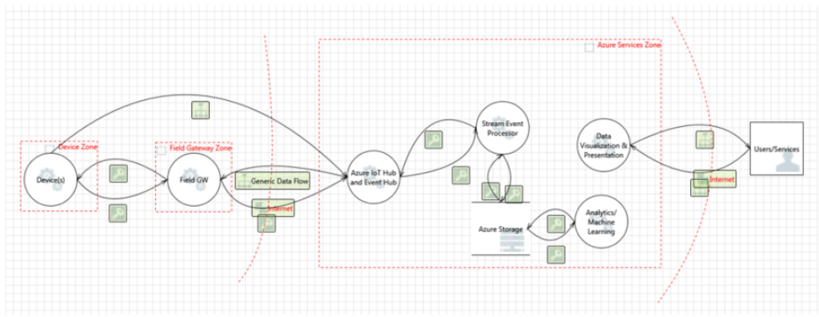
Threat modeling for the Azure IoT
We need to focus on following sections to perform threat modeling.
Devices and Data Sources,
Data Transport,
Device and Event Processing, and
Presentation

Slide 2
Device and data sources/data transport: followings are the core elements of thread model
Processes (both under your control and external items)
Communication (also called data flows)
Storage (also called data stores)
Device and event processing/cloud gateway zone
A cloud gateway is a system that enables remote communication from and to devices or field gateways from several different sites across public network space, typically towards a cloud-based control and data analysis system, a federation of such systems. In some cases, a cloud gateway may immediately facilitate access to special-purpose devices from terminals such as tablets or phones. In the context discussed here, “cloud” is meant to refer to a dedicated data processing system that is not bound to the same site as the attached devices or field gateways, and where operational measures prevent targeted physical access but is not necessarily to a “public cloud” infrastructure. A cloud gateway may potentially be mapped into a network virtualization overlay to insulate the cloud gateway and all of its attached devices or field gateways from any other network traffic. The cloud gateway itself is not a device control system or a processing or storage facility for device data; those facilities interface with the cloud gateway. The cloud gateway zone includes the cloud gateway itself along with all field gateways and devices directly or indirectly attached to it.
Services zone
A control system (or controller) is a software solution that interfaces with a device, or a field gateway, or cloud gateway for the purpose of controlling one or multiple devices and/or to collect and/or store and/or analyze device data for presentation, or subsequent control purposes. Control systems are the only entities in the scope of this discussion that may immediately facilitate interaction with people. The exceptions are intermediate physical control surfaces on devices, like a switch that allows a person to turn off the device or change other properties, and for which there is no functional equivalent that can be accessed digitally.

